Slide 1
HEART DISEASE PREDICTION WEBSITE
submitted By :
Abhinav Choudhary 2100290140002
(team leader)
Nikhil Kaushik 2100290140096
Vedant gotra 2100290140143
Akshay ChAudhary 2100290140010
Supervisor:
Dr. Vipin Kumar
Mr. Ankit Verma

Slide 2
INTRODUCTION
It might have happened so many times that you or someone yours need doctors help immediately, but they are not available due to some reason.
The Heart Disease Prediction application is an end user support and online consultation project.
Here, we propose a web application that allows users to get instant guidance on their heart disease through an intelligent system online.
The application is fed with various details and the heart disease associated with those details.

Slide 3
INTRODUCTION
The application allows user to share their heart related issues.
It then processes user specific details to check for various illness that could be associated with it.
Here we use some special Algorithms which analyses the details of the user and predict whether he has heart disease or not.
The system can be use in case of emergency.

Slide 4


TECHNOLOGIES
ReactJS is a declarative, efficient, and flexible JavaScript library for building reusable UI components. It is an open-source, component-based front end library responsible only for the view layer of the application. It was created by Jordan Walke, who was a software engineer at Facebook. It was initially developed and maintained by Facebook and was later used in its products like WhatsApp & Instagram. Facebook developed ReactJS in 2011 in its newsfeed section, but it was released to the public in the month of May 2013.
A ReactJS application is made up of multiple components, each component responsible for outputting a small, reusable piece of HTML code. The components are the heart of all React applications.
Flask is an API of Python that allows us to build up web-applications. It was developed by Armin Ronacher. Flask’s framework is more explicit than Django’s framework and is also easier to learn because it has less base code to implement a simple web-Application. A Web-Application Framework or Web Framework is the collection of modules and libraries that helps the developer to write applications without writing the low-level codes such as protocols, thread management, etc.

Slide 5


TECHNOLOGIES
MySQL is a very popular open-source relational database management system (RDBMS).
MySQL is a fast, easy-to-use RDBMS being used for many small and big businesses.
MySQL is becoming so popular because of many good reasons −
MySQL is released under an open-source license. So you have nothing to pay to use it.
MySQL is a very powerful program in its own right. It handles a large subset of the functionality of the most expensive and powerful database packages.
MySQL uses a standard form of the well-known SQL data language.
MySQL works very quickly and works well even with large data sets.
MySQL is customizable. The open-source GPL license allows programmers to modify the MySQL software to fit their own specific environments.
Scikit-learn (Sklearn) is the most useful and robust library for machine learning in Python. It provides a selection of efficient tools for machine learning and statistical modeling including classification, regression, clustering and dimensionality reduction via a consistence interface in Python. This library, which is largely written in Python, is built upon NumPy, SciPy and Matplotlib.

Slide 6
BENEFITS
User can talk about their Heart Disease and get instant diagnosis.
Users Health details are collected which can be used to analyses another disease also.
Very useful in case of emergency.

Slide 7
HARDWARE AND SOFTWARE USED :
Operating System: Window 10
Processor : Intel core™ i5-10210U CPU @ 1.60GHz 2.11 GHz
System Type : 64 bit
IDE : V.S Code , Pycharm.

Slide 8
MODULE
The system comprises of 2 major modules as follows:
Admin Module :
• Add Training Data
• View User Details
• View Feedback
• View Training Data

Slide 9
MODULE
USER MODULE
1. Check Heart (By providing Details like)
Age in Year
Gender
Chest Pain Type
Fasting Blood Sugar
Resting Electrographic Results(Restecg)
Exercise Induced Angina(Exang)
The slope of the peak exercise ST segment.

Slide 10
MODULE
USER MODULE
CA – Number of major vessels colored by fluoroscopy
Thal
Trest Blood Pressure
Serum Cholesterol
Maximum heart rate achieved(Thalach)
ST depression induced by exercise(Oldpeak)
2. Give Feedback

Slide 11
OUTCOME
Created a Website Providing instant heart disease Prediction.
It will predict if the user has a heart disease or not which can be helpful in Emergency cases and can be beneficial to track the heart health record of a user.

Slide 12
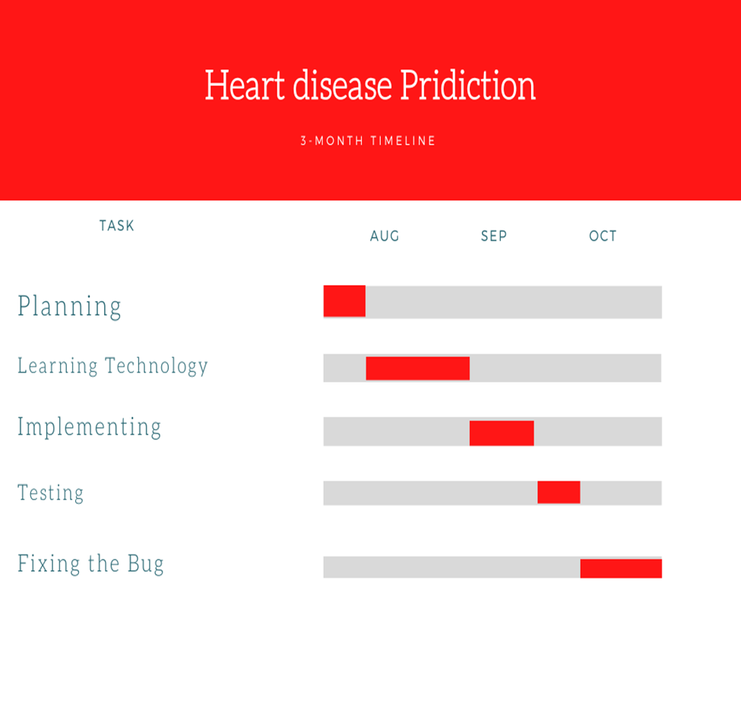
GANTT CHART

Slide 13


